Slide 1
Cryptography and Network Security
Chapter 3
Fourth Edition
by William Stallings
Lecture slides by Lawrie Brown
Notes:
Lecture slides by Lawrie Brown for “Cryptography and Network Security”, 4/e, by William Stallings, Chapter 3 – “Block Ciphers and the Data Encryption Standard”.

Slide 2
Chapter 3 – Block Ciphers and the Data Encryption Standard
Notes:
Intro quote.

Slide 3
Block vs Stream Ciphers
Block cipher:
  Message is encrypted block by block using same key.
  Divide the message into many blocks and then encrypt each block by using same key. All blocks will be of same size.
Stream cipher:
  Message is encrypted symbol by symbol using a stream of keys. Each symbol may be a bit, byte, a character or a block of small size.
  Used for encrypting live/streaming data
Notes:
Block ciphers work a on block / word at a time, which is some number of bits. All of these bits have to be available before the block can be processed. Stream ciphers work on a bit or byte of the message at a time, hence process it as a “stream”. Block ciphers are currently better analysed, and seem to have a broader range of applications, hence focus on them.

Slide 4
Think !
Encryption, expansion of data, compression
Dividing message into unequal block sizes

Slide 5
Claude Shannon and Substitution-Permutation Ciphers
Claude Shannon introduced idea of substitution-permutation (S-P) networks
S-P nets are based on the two primitive cryptographic operations seen before:
  substitution (S-box)
  permutation (P-box)
This provide confusion & diffusion of message & key
Notes:
Claude Shannon’s 1949 paper has the key ideas that led to the development of modern block ciphers. Critically, it was the technique of layering groups of S-boxes separated by a larger P-box to form the S-P network, a complex form of a product cipher. He also introduced the ideas of confusion and diffusion, notionally provided by S-boxes and P-boxes (in conjunction with S-boxes).

Slide 6
Confusion and Diffusion
diffusion – makes the statistical relationship between plaintext and ciphertext as complex as possible
  So the properties present in plaintext will not be carried over to ciphertext. Hence deduction of plaintext from ciphertext would be impossible
confusion – makes statistical relationship between Key and ciphertext as complex as possible
Both are used to thwart the attacks to deduce key or plain text from cipher text
Notes:
The terms diffusion and confusion were introduced by Claude Shannon to capture the two basic building blocks for any cryptographic system. Every block cipher involves a transformation of a block of plaintext into a block of ciphertext, where the transformation depends on the key. The mechanism of diffusion seeks to make the statistical relationship between the plaintext and ciphertext as complex as possible in order to thwart attempts to deduce the key. Confusion seeks to make the relationship between the statistics of the ciphertext and the value of the encryption key as complex as possible, again to thwart attempts to discover the key.
So successful are diffusion and confusion in capturing the essence of the desired attributes of a block cipher that they have become the cornerstone of modern block cipher design.

Slide 7
Data Encryption Standard (DES)
Notes:
The most widely used private key block cipher, is the Data Encryption Standard (DES). It was adopted in 1977 by the National Bureau of Standards as Federal Information Processing Standard 46 (FIPS PUB 46). DES encrypts data in 64-bit blocks using a 56-bit key. The DES enjoys widespread use. It has also been the subject of much controversy its security.

Slide 8
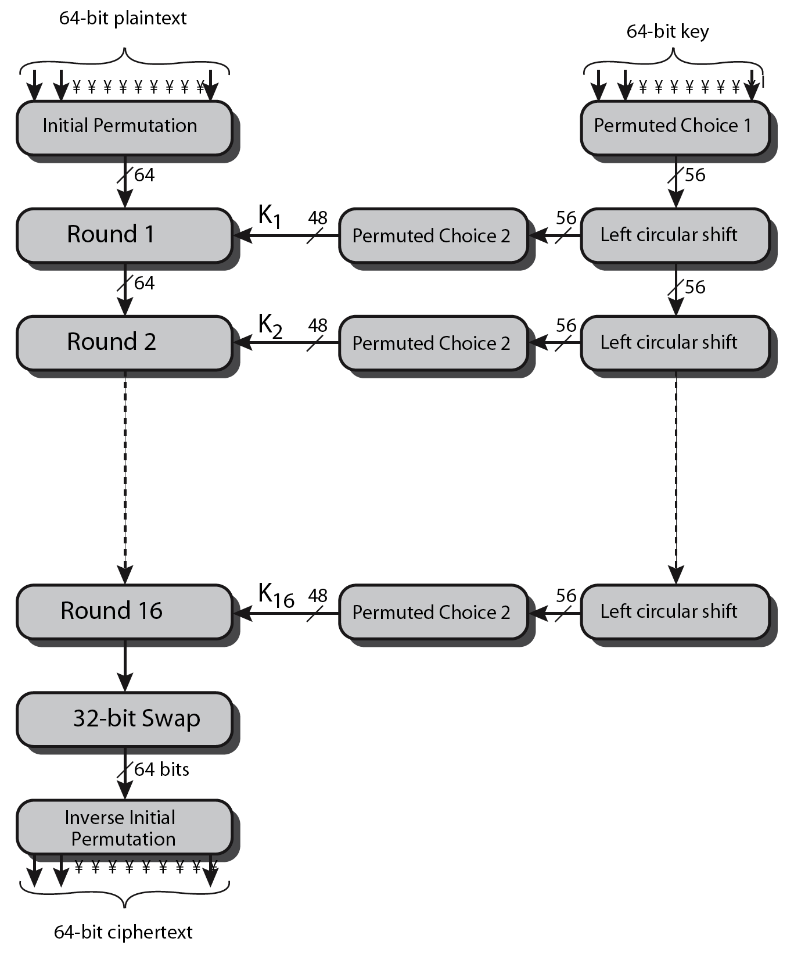
DES Encryption Overview
Notes:
The overall scheme for DES encryption is illustrated in Stallings Figure3.4, which takes as input 64-bits of data and of key.
The left side shows the basic process for enciphering a 64-bit data block which consists of:
- an initial permutation (IP) which shuffles the 64-bit input block
- 16 rounds of a complex key dependent round function involving substitutions & permutations
- a final permutation, being the inverse of IP
The right side shows the handling of the 56-bit key and consists of:
- an initial permutation of the key (PC1) which selects 56-bits out of the 64-bits input, in two 28-bit halves
- 16 stages to generate the 48-bit subkeys using a left circular shift and a permutation of the two 28-bit halves

Slide 9
Initial Permutation IP
IP reorders the input data bits
Note IP⁻¹ (IP (X))=x
Example Let X = 1001, IP = (3 1 4 2)
Then IP⁻¹ = (2 4 1 3)
IP(X) = 0110
IP⁻¹ (IP(X)) = IP⁻¹ (0110) = 1001 = X
Notes:
The initial permutation and its inverse are defined by tables, as shown in Stallings Tables 3.2a and 3.2b, respectively. The tables are to be interpreted as follows. The input to a table consists of 64 bits numbered left to right from 1 to 64. The 64 entries in the permutation table contain a permutation of the numbers from 1 to 64. Each entry in the permutation table indicates the position of a numbered input bit in the output, which also consists of 64 bits.
Note that the bit numbering for DES reflects IBM mainframe practice, and is the opposite of what we now mostly use - so be careful! Numbers from Bit 1 (leftmost, most significant) to bit 32/48/64 etc (rightmost, least significant).
Note that examples are specified using hexadecimal.
Here a 64-bit plaintext value of “675a6967 5e5a6b5a” (written in left & right halves) after permuting with IP becomes “ffb2194d 004df6fb”.

Slide 10
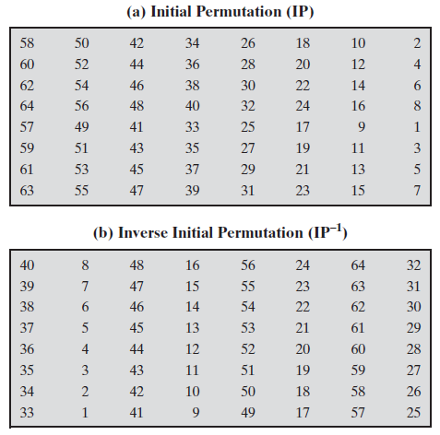

Slide 11
DES Round Structure
uses two 32-bit Left & Right halves
as in Feistel network:
  L_{i} = R_{i–1}
  R_{i} = L_{i–1} ⊕ F(R_{i–1}, K_{i})
F takes 32-bit R half and 48-bit subkey:
  expands R to 48-bits using permutation E
  Adds to subkey using XOR
  passes through 8 S-boxes to get 32-bit result
  finally permutes using 32-bit permutation P
Notes:
Detail here the internal structure of the DES round function F, which takes R half & subkey, and processes them through E, add subkey, S & P.
This follows the classic structure for a feistel cipher.
Note that the s-boxes provide the “confusion” of data and key values, whilst the permutation P then spreads this as widely as possible, so each S-box output affects as many S-box inputs in the next round as possible, giving “diffusion”.

Slide 12
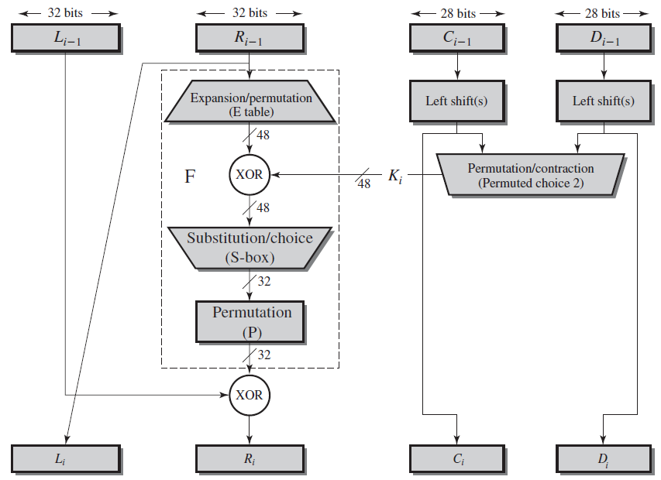

Slide 13
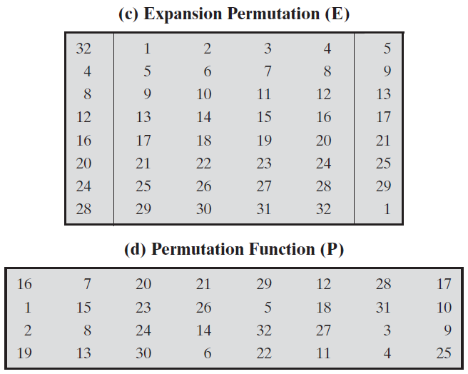

Slide 14
Substitution Boxes S
There are eight S-boxes.
Each S-box maps 6 bits to 4 bits:
  outer bits 1 & 6 (row bits) select one row of S-box
  inner bits 2-5 (col bits) select one column of S-box
  Intersection of row and column gives the substitution value (4-bits) for the given input of 6-bits.
Example:
  S(18 09 12 3d 11 17 38 39) = 5fd25e03
Notes:
The substitution consists of a set of eight S-boxes, each of which accepts 6 bits as input and produces 4 bits as output. These transformations are defined in Stallings Table 3.3, which is interpreted as follows: The first and last bits of the input to box Si form a 2-bit binary number to select one of four substitutions defined by the four rows in the table for Si. The middle four bits select one of the sixteen columns. The decimal value in the cell selected by the row and column is then converted to its 4-bit representation to produce the output. For example, in S1, for input 011001, the row is 01 (row 1) and the column is 1100 (column 12). The value in row 1, column 12 is 9, so the output is 1001.
The example lists 8 6-bit values (ie 18 in hex is 011000 in binary, 09 hex is 001001 binary, 12 hex is 010010 binary, 3d hex is 111101 binary etc), each of which is replaced following the process detailed above using the appropriate S-box. ie
S1(011000) lookup row 00 col 1100 in S1 to get 5
S2(001001) lookup row 01 col 0100 in S2 to get 15 = f in hex
S3(010010) lookup row 00 col 1001 in S3 to get 13 = d in hex
S4(111101) lookup row 11 col 1110 in S4 to get 2 etc

Slide 15

DES Round Structure
Notes:
Stallings Figure 3.6 illustrates the internal structure of the DES round function F. The R input is first expanded to 48 bits by using expansion table E that defines a permutation plus an expansion that involves duplication of 16 of the R bits (Stallings Table 3.2c). The resulting 48 bits are XORed with Ki. This 48-bit result passes through a substitution function comprising 8 S-boxes which each map 6 input bits to 4 output bits, producing a 32-bit output, which is then permuted by permutation P as defined by Stallings Table 3.2d.

Slide 16
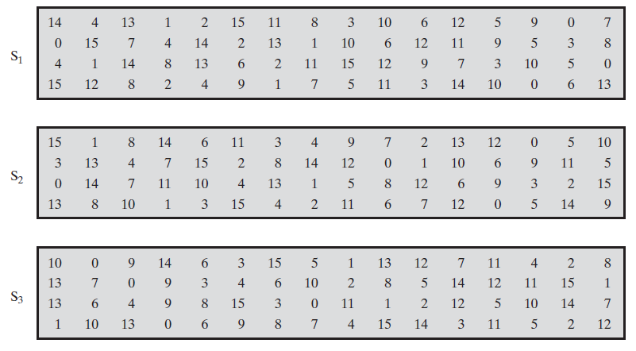

Slide 17
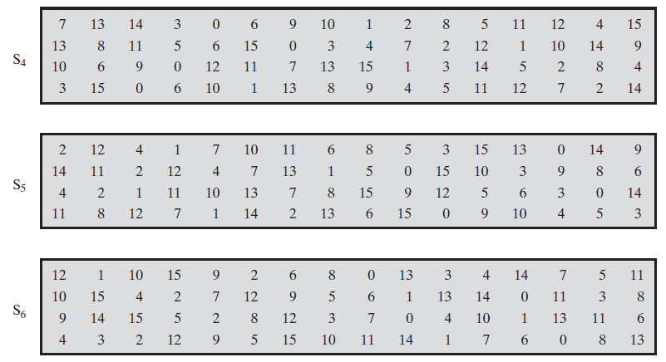

Slide 18
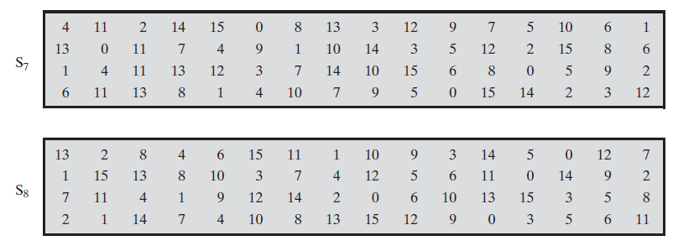

Slide 19
DES Subkey generation
Generates one subkey for each round. There are 16 rounds. So 16 subkeys are generated.
Input key size is 64 bits. Ignore every 8th bit to get 56 bits of key
Refer following fig where last column is ignored.
Notes:
The DES Key Schedule generates the subkeys needed for each data encryption round. The 64-bit key input is first processed by Permuted Choice One (Stallings Table 3.4b). The resulting 56-bit key is then treated as two 28-bit quantities C & D. In each round, these are separately processed throgh a circular left shift (rotation) of 1 or 2bits as shown in Stallings Table 3.4d. These shifted values serve as input to the next round of the key schedule. They also serve as input to Permuted Choice Two (Stallings Table 3.4c), which produces a 48-bit output that serves as input to the round function F.
The 56 bit key size comes from security considerations as we know now. It was big enough so that an exhaustive key search was about as hard as the best direct attack (a form of differential cryptanalysis called a T-attack, known by the IBM & NSA researchers), but no bigger. The extra 8 bits were then used as parity (error detecting) bits, which makes sense given the original design use for hardware communications links. However we hit an incompatibility with simple s/w implementations since the top bit in each byte is 0 (since ASCII only uses 7 bits), but the DES key schedule throws away the bottom bit! A good implementation needs to be cleverer!

Slide 20
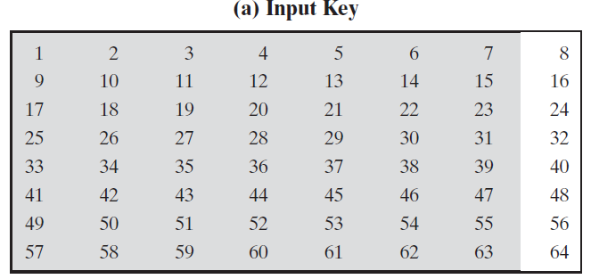

Slide 21
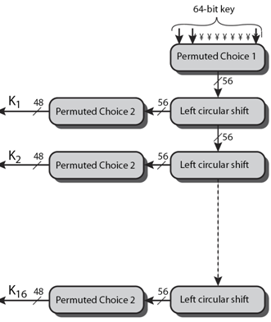

Slide 22
Subkey gen…
Apply permutation called Permuted choice 1 (PC1) on the key
Divide resultant 56-bits key into two 28-bit halves C₀ and D₀
Apply left circular shift (rotation) of 1 or 2 bits as in the key rotation table on C₀ and D₀ This is input to the next round and also to PC2
Apply permutation called Permuted choice 2 (PC2) on the key C₀IID₀ to get 48 bits subkey

Slide 23
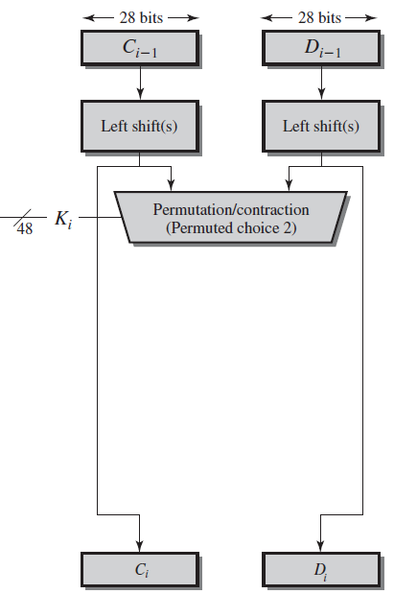

Slide 24
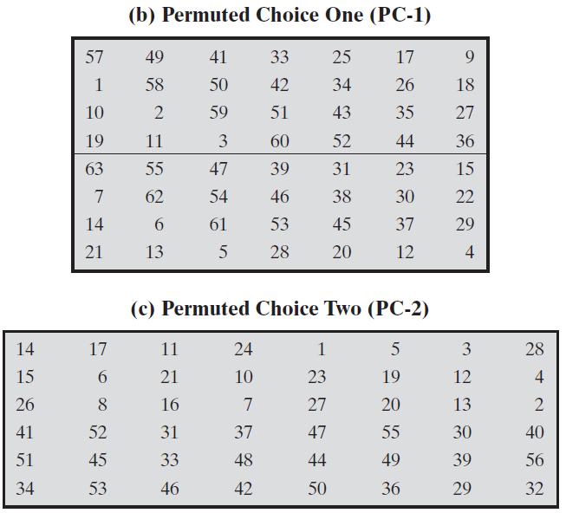

Slide 25


Slide 26
DES Decryption
For decryption, apply encryption with subkeys in the reverse order K16, K15, ... , K1
Notes:
As with any Feistel cipher, DES decryption uses the same algorithm as encryption except that the subkeys are used in reverse order SK16 .. SK1.
If you trace through the DES overview diagram can see how each decryption step top to bottom with reversed subkeys, undoes the equivalent encryption step moving from bottom to top.

Slide 27
Strength of DES algorithm
Avalanche effect
Brute force attack
Timing attack
Differential cryptanalysis
Linear cryptanalysis

Slide 28
Avalanche Effect
A small change either in plain text or in key results in a significant change in cipher text
DES exhibits strong avalanche property
Notes:
A desirable property of any encryption algorithm is that a small change in either the plaintext or the key should produce a significant change in the ciphertext. In particular, a change in one bit of the plaintext or one bit of the key should produce a change in many bits of the ciphertext. If the change were small, this might provide a way to reduce the size of the plaintext or key space to be searched. DES exhibits a strong avalanche effect, as may be seen in Stallings Table 3.5.

Slide 29
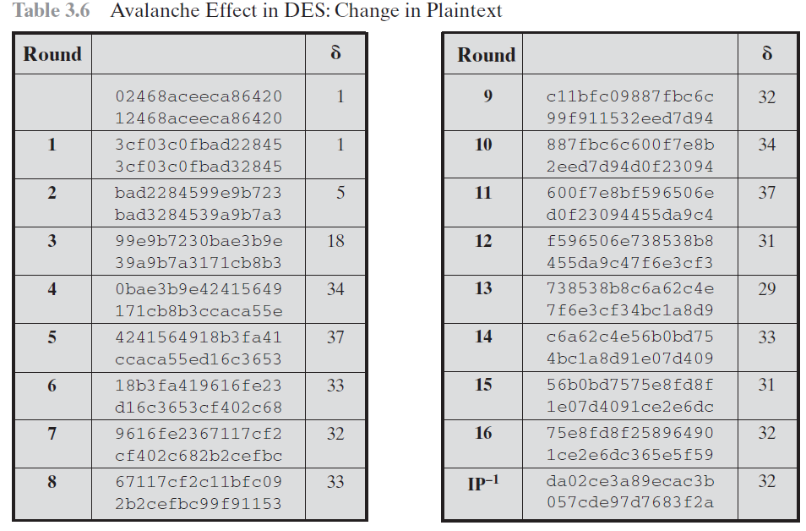

Slide 30
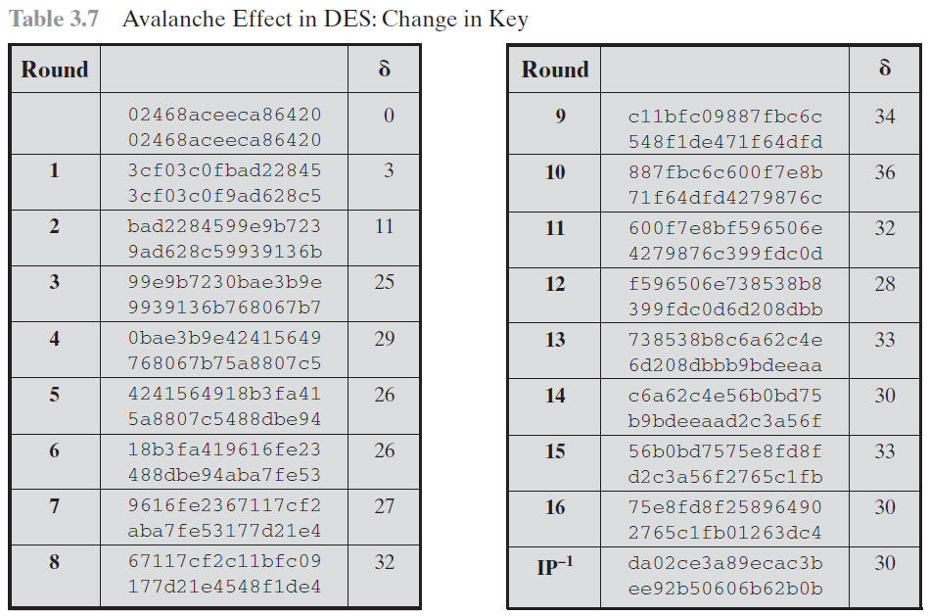
Key1: 0f1571c947d9e859
Key2: 1f1571c947d9e859

Slide 31
Brute force Attack
Since key size is 56 bits, there are 2⁵⁶ Keys (approx 7.2 X 10¹⁶ keys)
A machine performing 1 encryption /micro sec needs > 1000 years to break a cipher.
A special purpose computer called “DES cracker” breaks cipher in < 3 days.
  So DES was replaced by 3DES, AES

Slide 32
Timing Attacks
Information about plain text / key can be deduced by observing the amount of time taken for decrypting various cipher texts.
DES is resistant to timing attacks.
Notes:
We will discuss timing attacks in more detail later, as they relate to public-key algorithms. However,the issue may also be relevant for symmetric ciphers. A timing attack is one in which information about the key or the plaintext is obtained by observing how long it takes a given implementation to perform decryptions on various ciphertexts. A timing attack exploits the fact that an encryption or decryption algorithm often takes slightly different amounts of time on different inputs. The AES analysis process has highlighted this attack approach, and showed that it is a concern particularly with smartcard implementations, though DES appears to be fairly resistant to a successful timing attack.

Slide 33

Differential Cryptanalysis
DES is resistant to this attack.
Start with two messages m & m’ with known XOR difference
searching for a known difference in output
Deduce the key bits
It uses 2^47 chosen plain texts
Notes:
Biham & Shamir show Differential Cryptanalysis can be successfully used to cryptanalyse the DES with an effort on the order of 2⁴⁷ encryptions, requiring 2⁴⁷ chosen plaintexts. They also demonstrated this form of attack on a variety of encryption algorithms and hash functions.
Differential cryptanalysis was known to the IBM DES design team as early as 1974 (as a T attack), and influenced the design of the S-boxes and the permutation P to improve its resistance to it. Compare DES’s security with the cryptanalysis of an eight-round LUCIFER algorithm which requires only 256 chosen plaintexts, verses an attack on an eight-round version of DES requires 2¹⁴ chosen plaintexts.

Slide 34
Linear Cryptanalysis
can attack DES with 2⁴³ known plaintexts
Theoretically possible but practically infeasible.
find linear approximations
  P[i₁,i₂,...,i_{a}] ⊕ C[j₁,j₂,...,j_{b}] = K[k₁,k₂,...,k_{c}]
  where i_{a},j_{b},k_{c} are bit locations in P,C,K
Deduce the key bits
Notes:
A more recent development is linear cryptanalysis. This attack is based on finding linear approximations to describe the transformations performed in DES. This method can find a DES key given 2^43 known plaintexts, as compared to 2^47 chosen plaintexts for differential cryptanalysis. Although this is a minor improvement, because it may be easier to acquire known plaintext rather than chosen plaintext, it still leaves linear cryptanalysis infeasible as an attack on DES. Again, this attack uses structure not seen before. So far, little work has been done by other groups to validate the linear cryptanalytic approach.

Slide 35
DES Design Criteria
S-boxes provide
  non-linearity
  resistance to differential cryptanalysis
  good confusion
permutation P provides
  increased diffusion
Notes:
Although much progress has been made in designing block ciphers that are cryptographically strong, the basic principles have not changed all that much since the work of Feistel and the DES design team in the early 1970s. Some of the criteria used in the design of DES were reported in [COPP94], and focused on the design of the S-boxes and on the P function that distributes the output of the S boxes, as summarized above. See text for further details.

